Slide 1



AI Engineering
Full time Cohort
IMAGE PROCESSING

Slide 2
Image Processing
Intro to image processing
“Image-as-a-data-structure”
Filtering
Segmentation
Feature Extraction
Machine Learning

Slide 3
Intro to image processing
How can we use what we have already learned, to classify images?
We need to understand what an image is. But first, lets review what a signal is...
Welcome

Slide 4

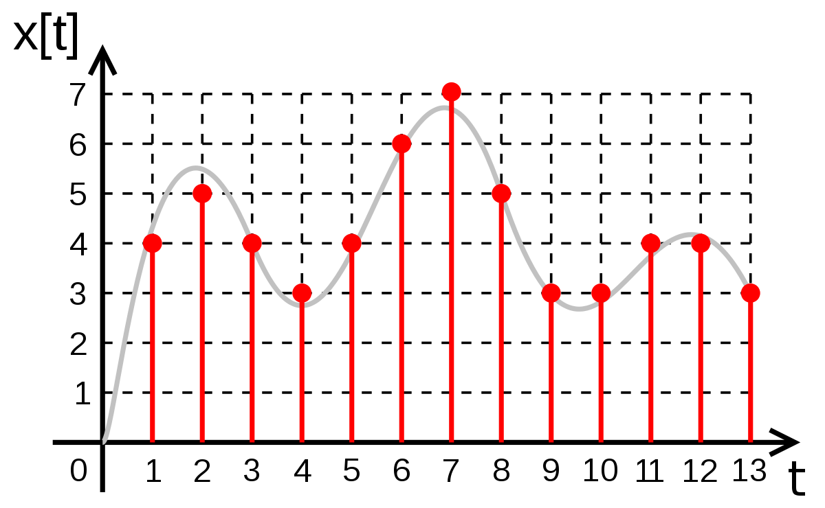
Intro to image processing
How can we use what we have already learned, to classify images?
We need to understand what an image is. But first, lets review what a signal is...
What is the difference between this and this?
Welcome

Slide 5
Intro to image processing
1D signal
4 | 5 | 4 | 3 | 4 | 6 | 7 | 5 | 3 | 3 | 4 | 4 | 3
2D Visual representation of index vs intensity
Welcome

Slide 6
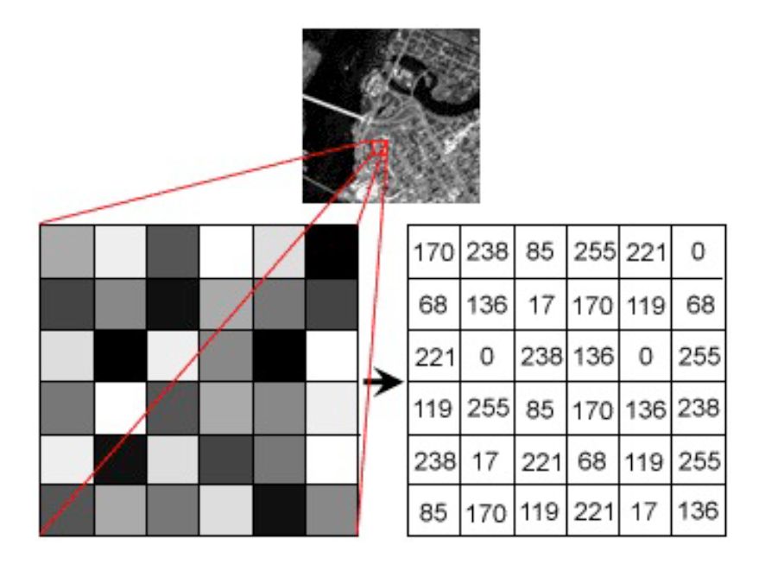
Intro to image processing
The same happens in an image, but in 2D
Welcome

Slide 7
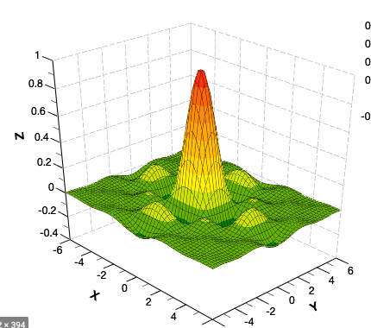
Intro to image processing
The same happens in an image, but in 2D

Slide 8
Intro to image processing
This means an image can be interpreted the same way a signal (column in pandas dataframe) is, but with an extra dimension (which kinda makes this harder to understand).
However, the same techniques and data processing that we have learned for 1D problems, can be applied in 2D for images.

Slide 9
Intro to image processing
This means an image can be interpreted the same way a signal (column in pandas dataframe) is, but with an extra dimension (which kinda makes this harder to understand).
However, the same techniques and data processing that we have learned for 1D problems, can be applied in 2D for images.
But before we go there… in technical terms, which structures can we use to handle images in Python?
Welcome

Slide 10
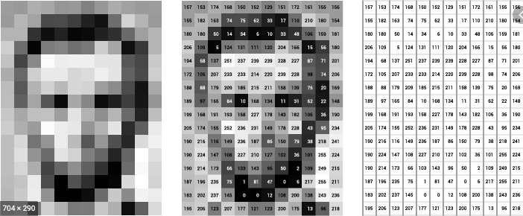
Image as a structure: Greyscale
Welcome

Slide 11
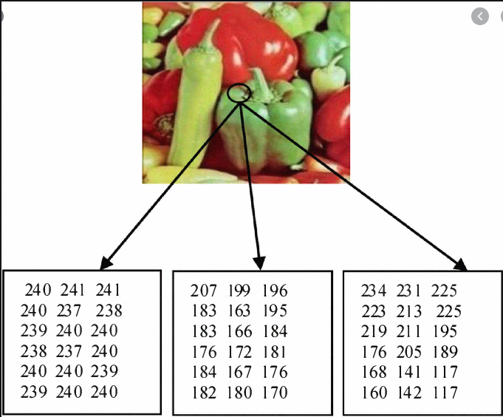
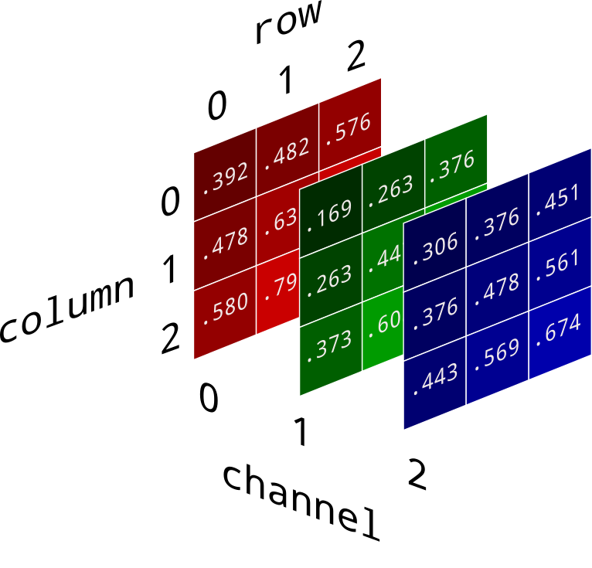
Image as a structure: RGB
R
G
B
Welcome

Slide 12
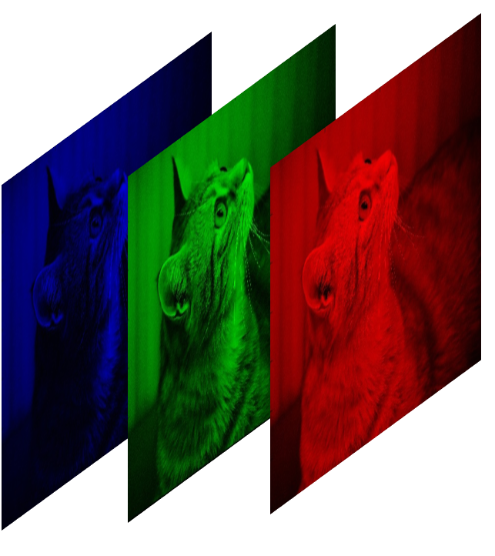
Image as a structure: Video
frame
t
Welcome

Slide 13
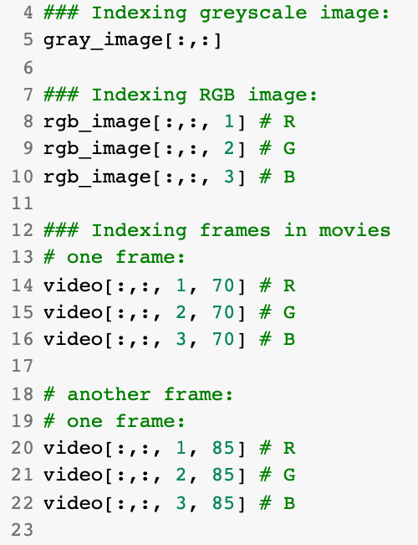
Image as a structure: np array
A simple way to handle images in is simply a
2D (greyscale), 3D (RGB) or 4D (Video)
Welcome

Slide 14
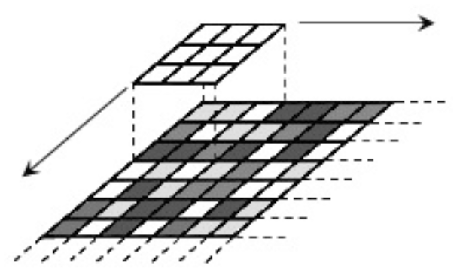
Filtering
Welcome

Slide 15
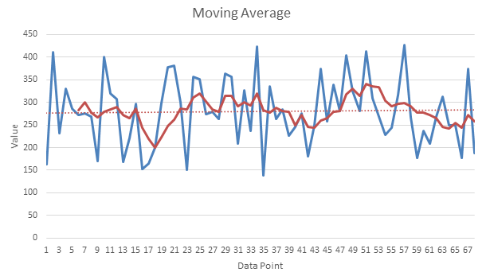
Filtering
Let’s recall moving average filters for smoothing in TimeSeries:
Replace the value of that position by the mean of all the points inside the window
Welcome

Slide 16
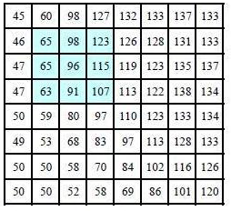
Filtering
Let’s recall moving average filters for smoothing in TimeSeries:
Replace the value of that position by the mean of all the points inside the window
Welcome

Slide 17
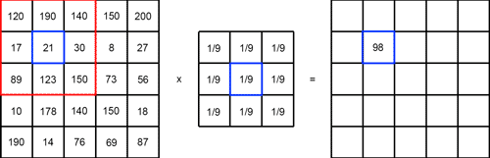
Filtering
Welcome

Slide 18
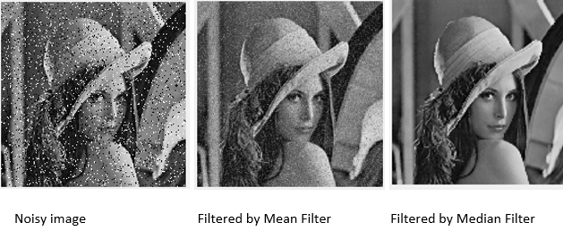
Filtering
Welcome

Slide 19
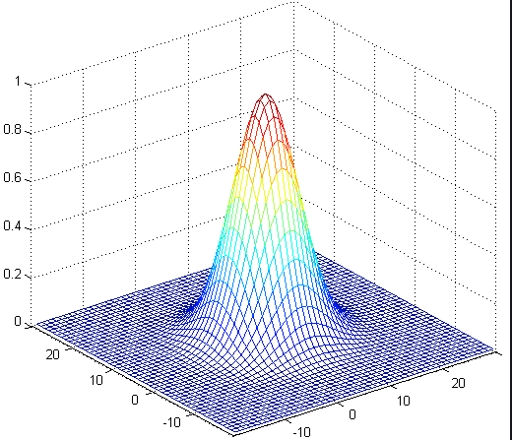
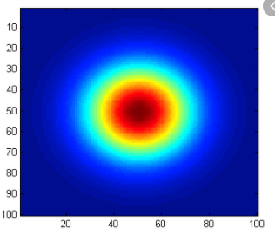
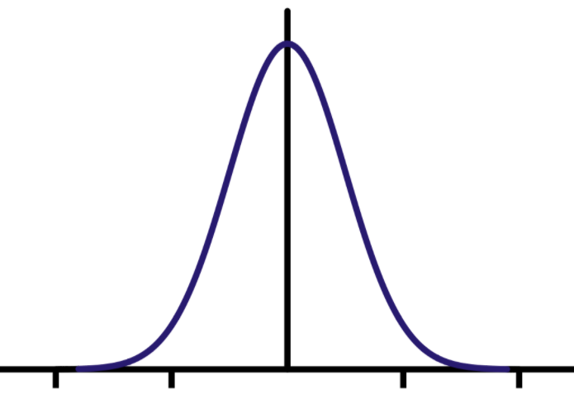
Filtering, Smoothing and Edge Detection
We can apply different types of filters (not just a mean)
A very common one is a GAUSSIAN filtering.
Mean Filter: All the points have the same impact
Gaussian Filter: The closer points have more impact than the further points
Welcome

Slide 20
Filtering, Smoothing and Edge Detection
We can apply different types of filters (not just a mean)
A very common one is a GAUSSIAN filtering.
Mean Filter: All the points have the same impact
Gaussian Filter: The closer points have more impact than the further points
Welcome

Slide 21
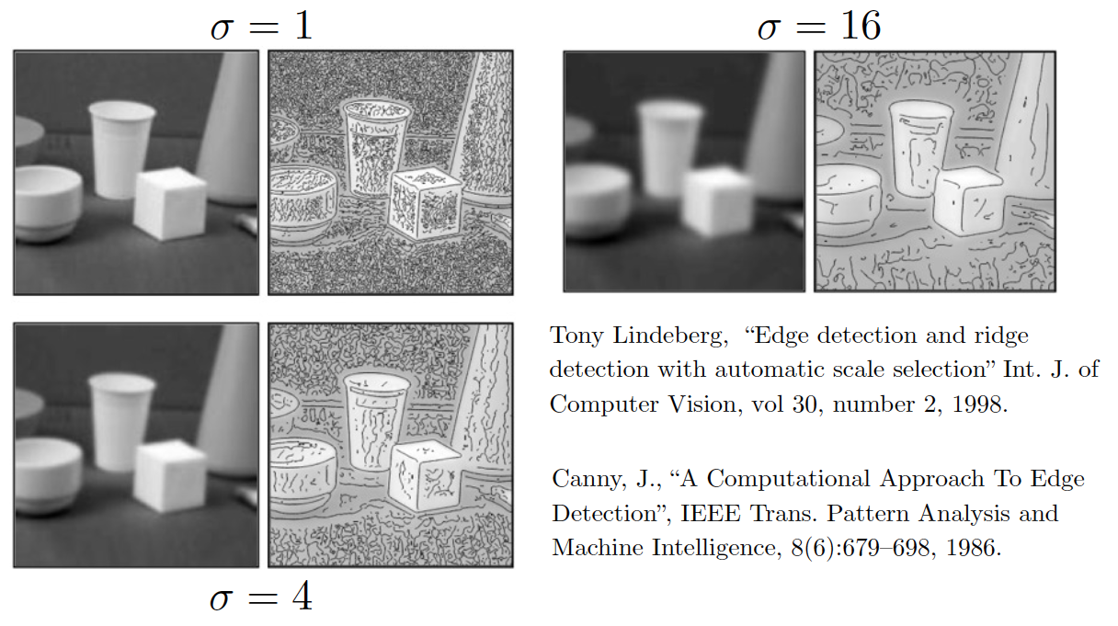
Smoothing and Edge Detection
Welcome

Slide 22
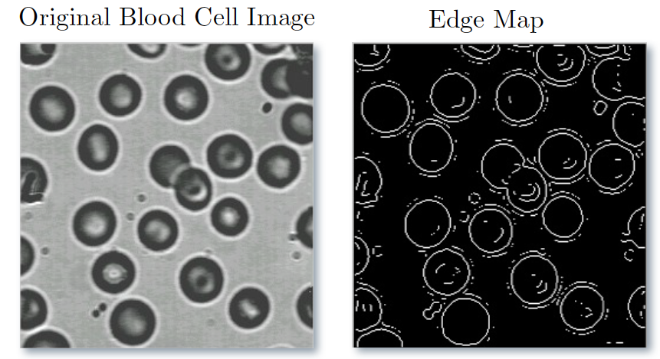
Segmentation and Edge Detection
Welcome

Slide 23
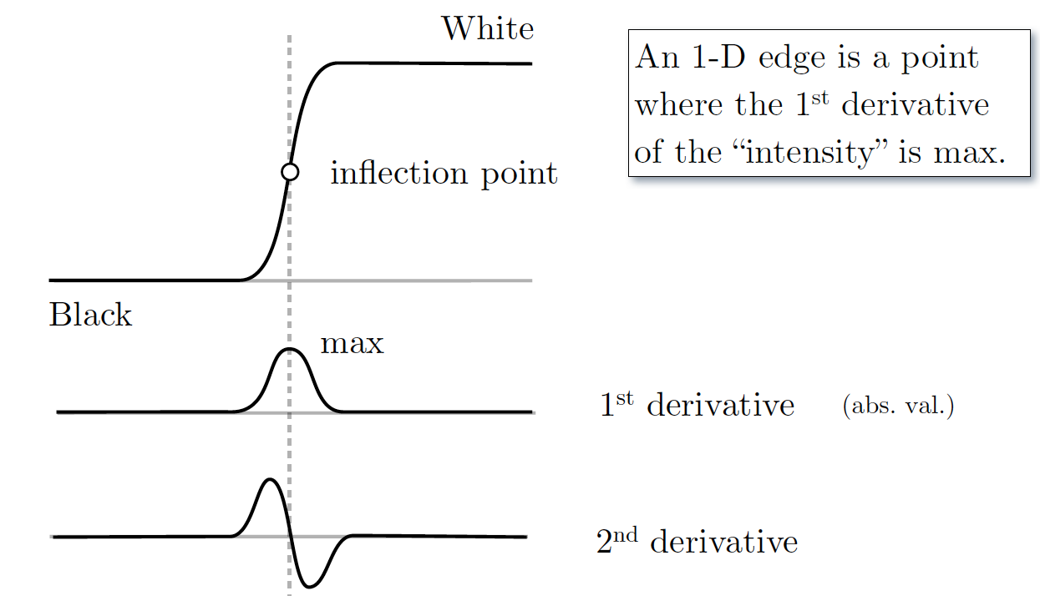
Segmentation and Edge Detection
Welcome

Slide 24
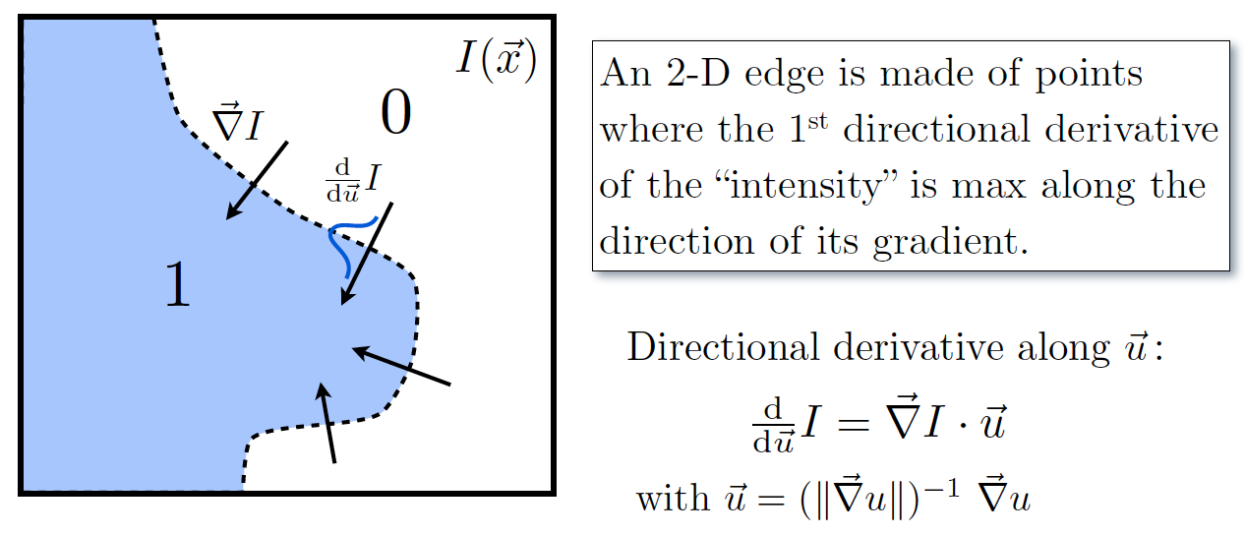
Segmentation and Edge Detection
Welcome

Slide 25
Features and Clustering
Feature extraction is an important step in image processing, as it is the step where you think “what information am I going to collect from the image.
You can tackle this problem in a couple ways (depending on the use case):
A simple one is to go pixel by pixel and cluster them
Welcome

Slide 26
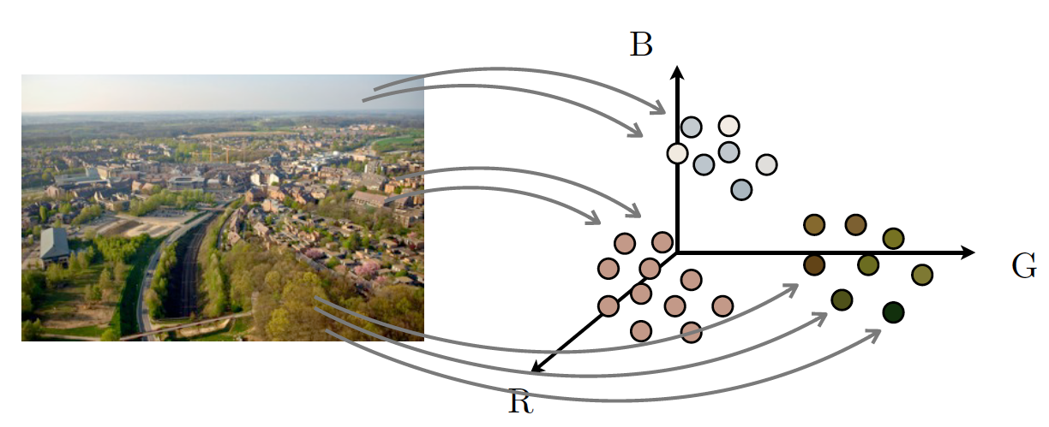
Features and Clustering
Welcome

Slide 27
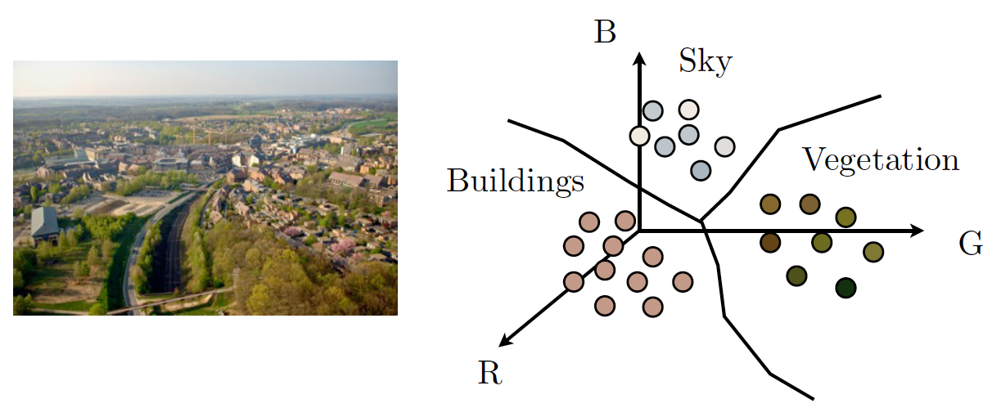
Features and Clustering
Welcome

Slide 28
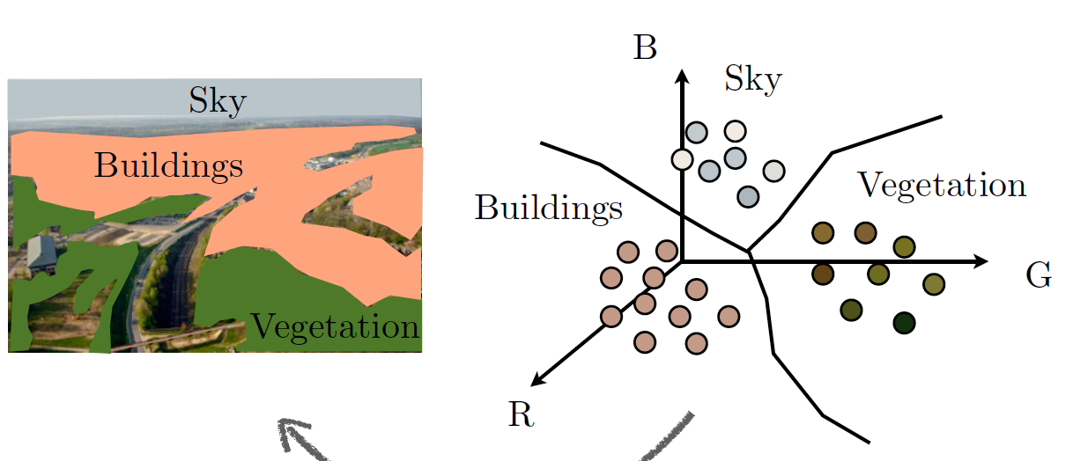
Features and Clustering
Welcome

Slide 29
Features and Clustering
Feature extraction is an important step in image processing, as it is the step where you think “what information am I going to collect from the image.
You can tackle this problem in a couple ways (depending on the use case):
A simple one is to go pixel by pixel and cluster them
Another can be to extract information from the segmented regions:
Welcome

Slide 30
Machine Learning and Image Processing
This part you already know :). From here, you can do:
Unsupervised learning to split the regions/pixels of the image into clusters (e.g, you know it is a man in front of a white wall. Unsupervised learning will
Supervised Learning for:
Facial Recognition
Object detection
OCR (Optical character recognition)
And much more...
Welcome

Slide 31
Machine Learning and Image Processing - Point of attention
There are many aspects of dealing with Images that go out of scope here - more related to the technical part of image processing (image compression, jpeg vs png, etc) then to data analysis, as well as many Feature Extraction techniques dedicated to Image Processing (e.g, Mathematical Morphology)
Although we will skip it here, please be aware that these have quite the strong impact when doing machine learning for image processing.
Welcome

Slide 32
Thank you
Let’s get started!

Slide 33
Appendix
Welcome

Slide 34
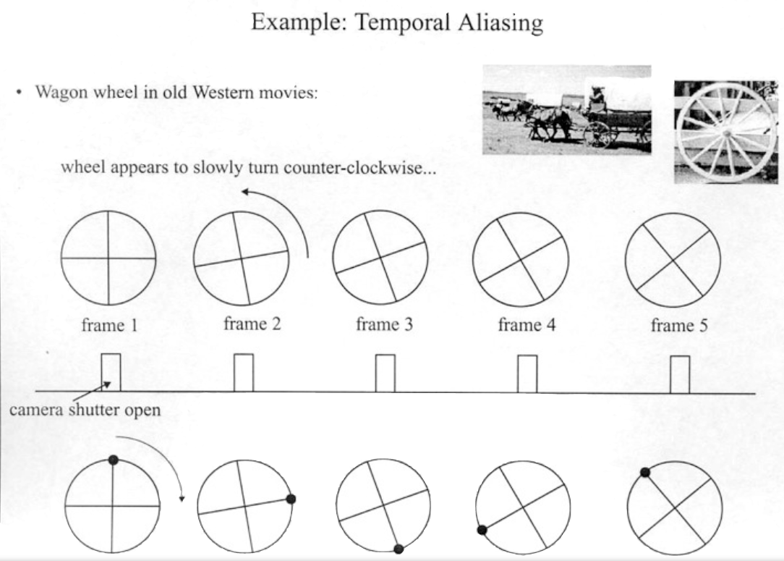

Welcome

Slide 35
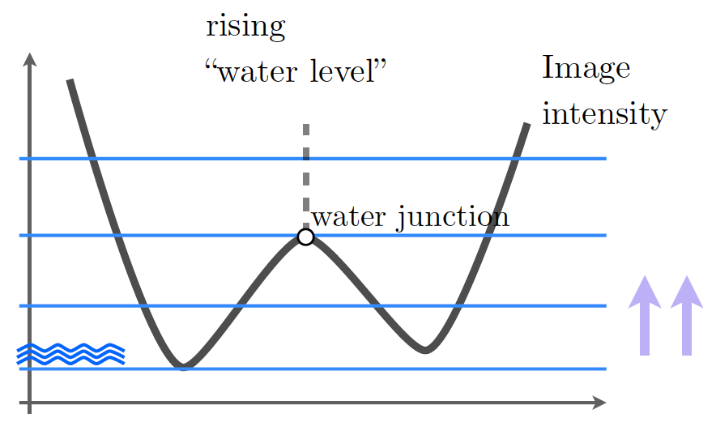
Segmentation and Edge Detection - Watershed method
Welcome

Slide 36
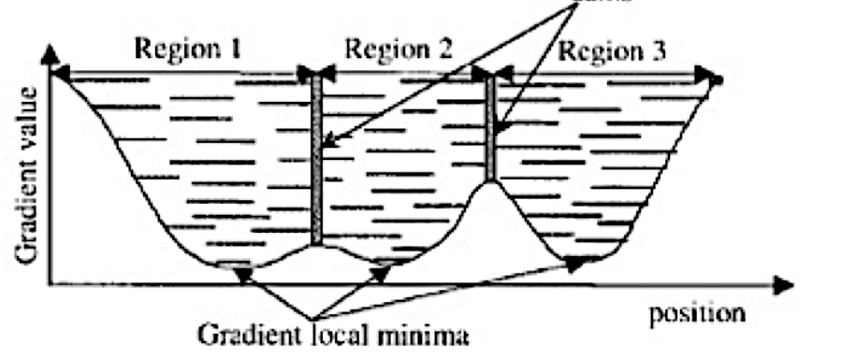
Segmentation and Edge Detection - Watershed method
Welcome

Slide 37
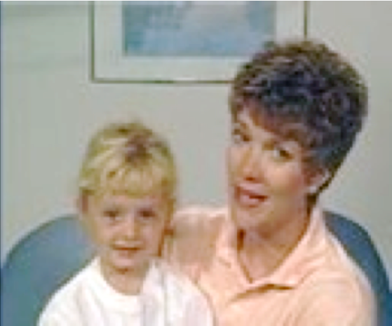
Segmentation and Edge Detection
Welcome

Slide 38
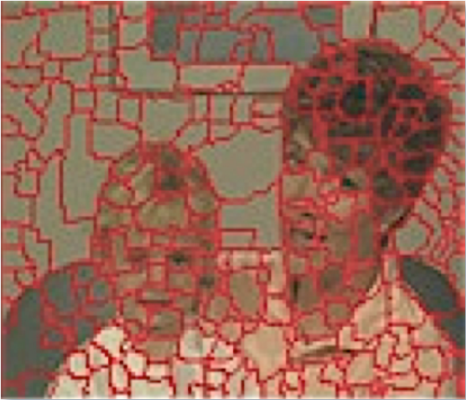
Segmentation and Edge Detection
Welcome

Slide 39
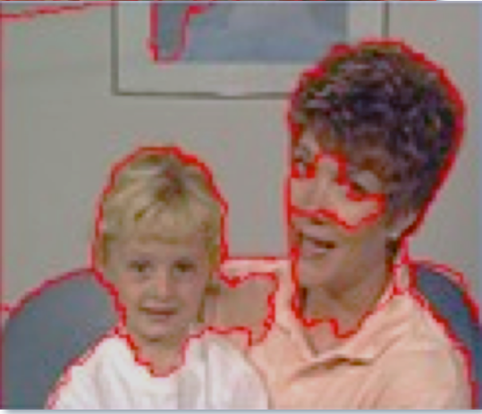
Segmentation and Edge Detection
Welcome

Slide 40
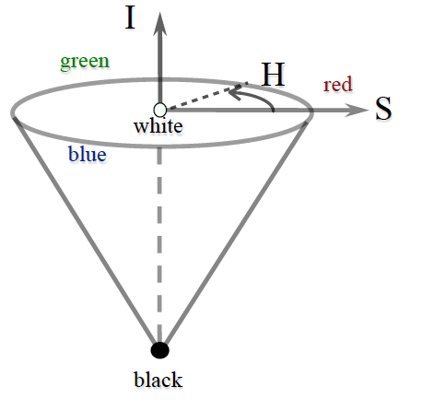
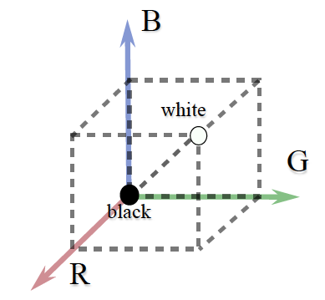

Welcome

